Slide 1

EHC Training
Linux basics

Slide 2

Contents
Overview
Distros
Shell
Environment variables
Basic commands

Slide 3
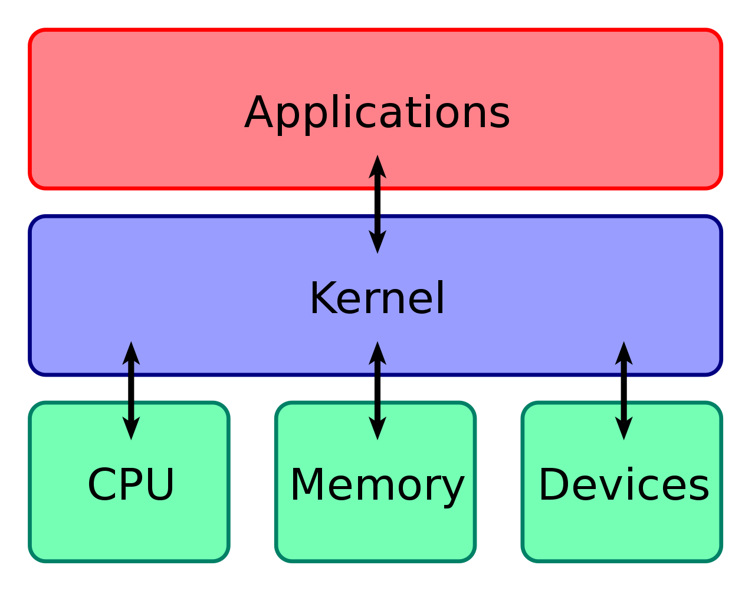
Overview

Slide 4

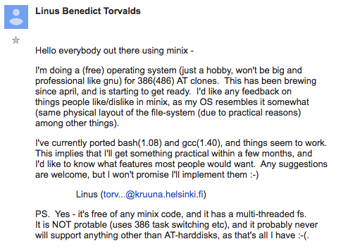
History
- 1991, began a project that later became the Linux Kernel.
- 1922, Linux started to be released under GPL (GNU General Public License), gave birth to a complete OS, GNU/Linux
- We can find the timeline of Linux Distros here
- As a legend should do, Linus Torvalds created Git to maintain the Linux Kernel’s releases, but soon, it becomes the most famous Version Control System.

Slide 5
Kernel
- The kernel is a computer program at the core of a computer's operating system and generally has complete control over everything in the system.
- Linux is an open-source kernel, which means you can build your own Distro with it here

Slide 6
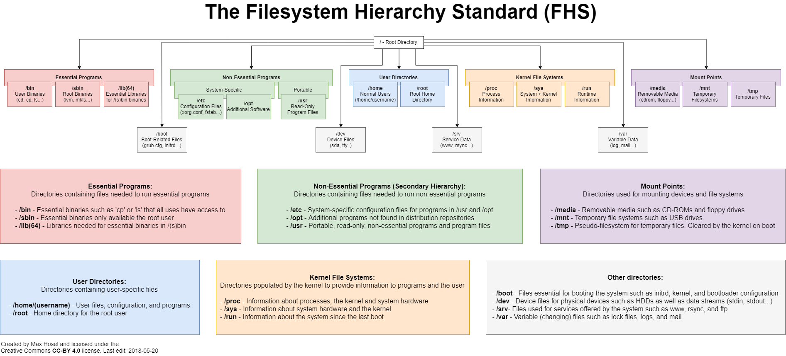
Filesystem Hierarchy Standard (FHS)
Notes:
Full-size image: https://external-preview.redd.it/JKYkgkWMKu4FStR49umwXIwR2BV1bjhH4wM6d9fvCgk.png?auto=webp&s=1247e7df2a1c937cd598b3252d74ef7bf2b18798

Slide 7
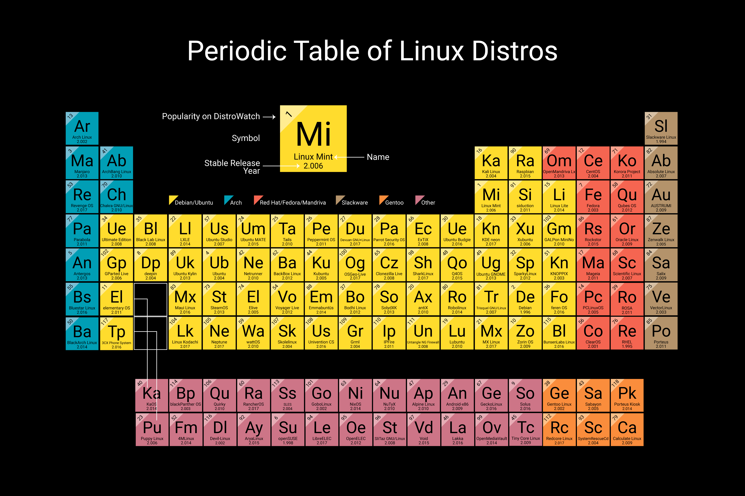
Distros
- A Distro is a Complete Operating System based on Linux Kernel
- There are 3 ways to categorize Linux Distros:
By purposes: desktop, workstation, server, …
By configurations: package manage, FHS, …
By support models: community and enterprise.

Slide 8
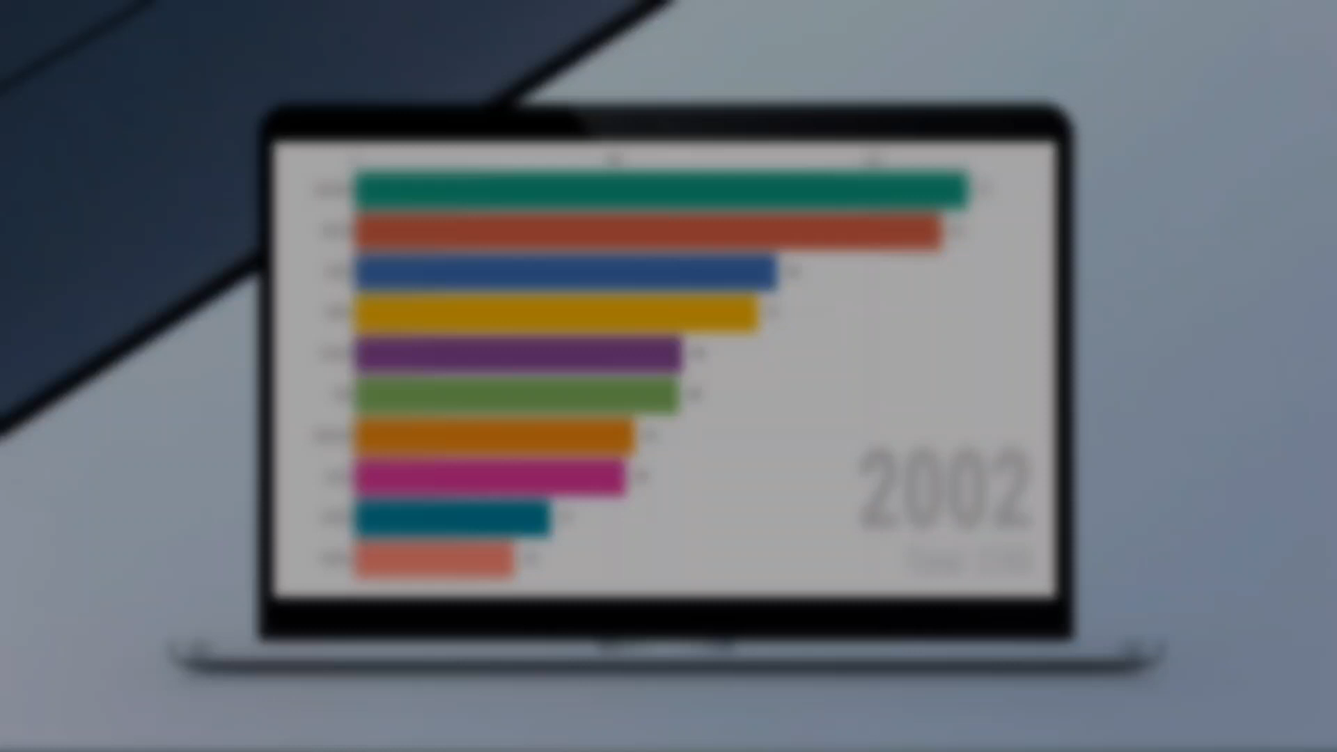
Some famous Distros

Slide 9

Linux Mint
Debian-based
Stable
User friendly

Slide 10

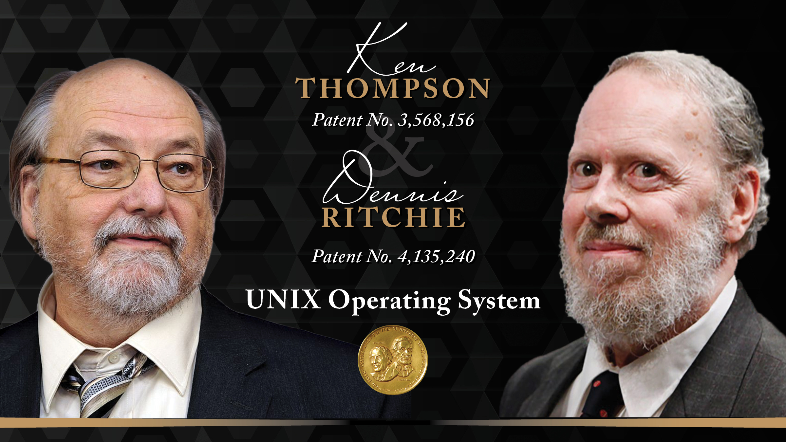
Shell
- The concept Shell was developed by Ken Thompson in 1971
- Shell is an environment in which we can run our commands, programs, and shell scripts.
- A Shell provides you with an interface to the Unix system.
- There are different flavors of a shell, just as there are different flavors of operating systems.
- Each flavor of shell has its own set of recognized commands and functions.

Slide 11

Bash
- Back to 1979, Stephen Bourne developed Bourne Shell, the most popular Shell at that time.
- 1989, Brian Fox developed Bash to “make Bourne Shell great again”
- Bash is the most popular shell in Unix-based Systems, like Linux Distros and MacOS.

Slide 12
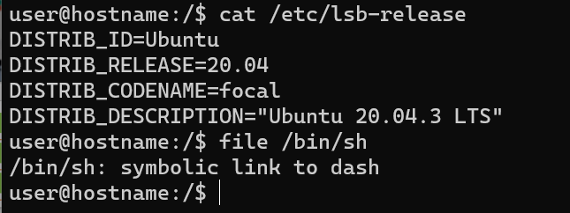
sh vs bash
- sh (or Shell Command Language) is a programming language described by the POSIX standard, which has many implementations (Bash, Dash, …).
- In Linux Systems, sh is a symlink to the default shell of system (its default implementation).
- Bash is one of the sh’s implementations.

Slide 13
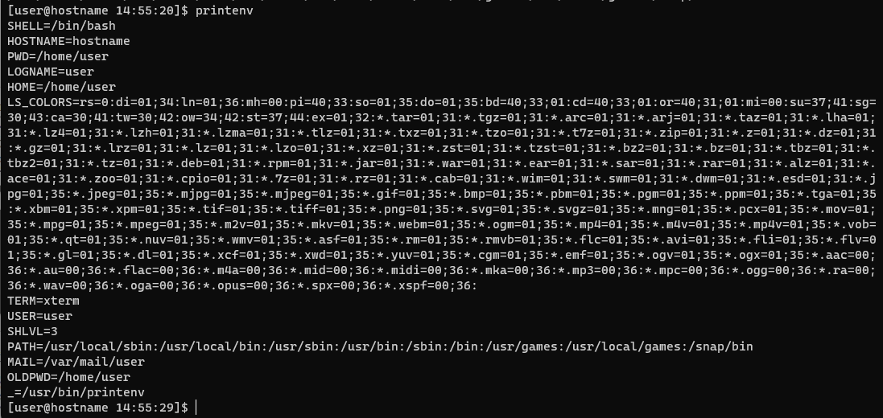
Environment Variables (ENVs)
- ENVs basically define the environment, can affect processes ongoing or the programs that are executed in the environment.

Slide 14
Some common ENVs
SHELL | The Shell you are using
TERM | The terminal using, eg: Xfce-Terminal, Gnome Terminal, Konsole, …
USER | Current username
PWD | Current working directory
OLDPWD | Previous working directory
LS_COLORS | Color codes used in ls command
PATH | List of directories that system will look for executables
LANG | Current language and localization settings include character encoding
HOME | Current user’s home directory
_ | The previous command
UID | UID of current user

Slide 15
Basic Commands
- When finds some hard-to-understand commands, try this web
- Some commands require sudo permission
-

